Slide 1
Assistance League
of Mid-Missouri®
Anne Banning Leadership Award
2024

Slide 2
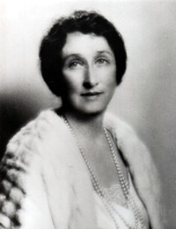
The Anne Banning
Leadership Award
Named after the founder of Assistance League.
Demonstrates the importance and value of leadership to Assistance League chapters.

Slide 3
The Anne Banning Leadership Award
Recognizes a member who has
Served in major leadership roles
Demonstrated enthusiasm, guidance, and participation in chapter programs and activities

Slide 4
The Anne Banning Leadership Award
Recognizes a member who has
Led in the creation of a new chapter program or initiative
Represented the chapter mission and values in the community

Slide 5
Assistance League of Mid-Missouri proudly presents its
second
Anne Banning Leadership Award
to . . .

Slide 6
Lynnanne Baumgardner
Music by ABBA, performed by Richard Clayderman

Slide 7
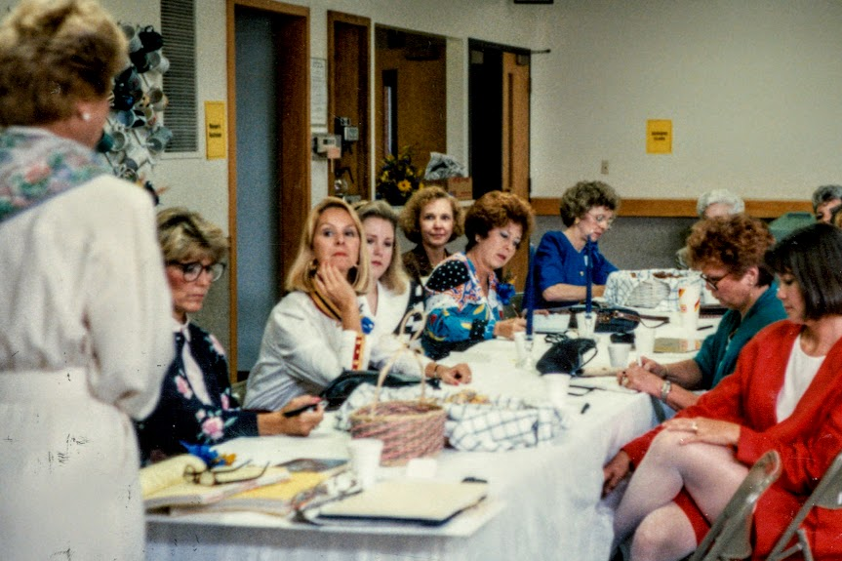
Lynnanne served on the first Assistance League board in September 1991.

Slide 8
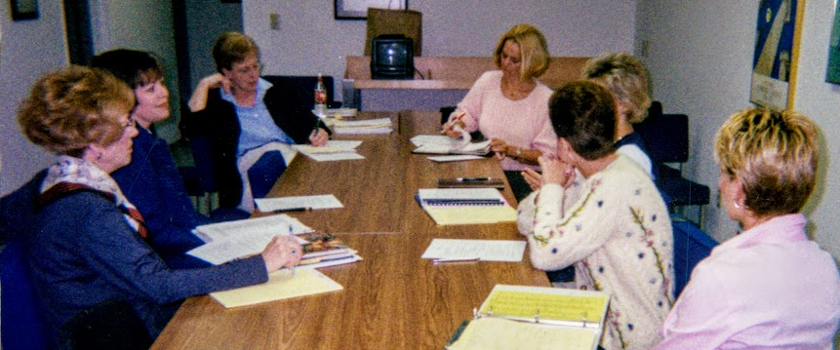
Lynnanne has served on many chapter boards since, in various positions:
President,
President-Elect,
VP Resource Development,
,
VP Public Relations
VP Strategic Planning,
Parliamentarian

Slide 9
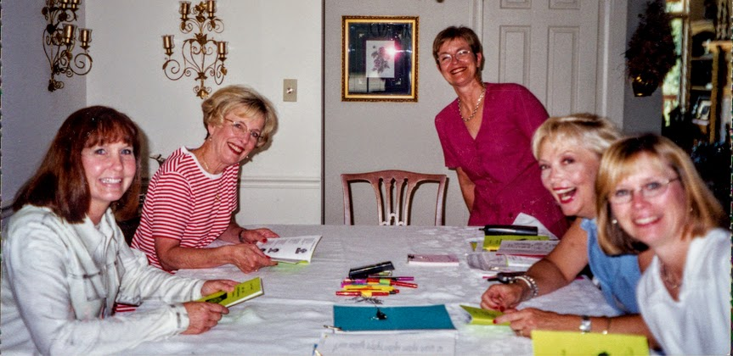
Lynnanne also served on many committees, often as chairman:
Public Relations,
Marketing,
Links to Learning,
I Wonder Bags,
Bundles for Babies,
Scholarship,
Cookie Connection,
Member Recognition,
Social,
Office Relocation,
Space and Expansion,
Nominating, Ambassadors

Slide 10
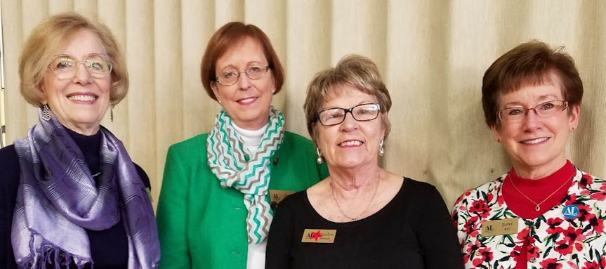
Lynnanne has also served on the national level as committee member for Strategic Planning and for Public Relations.
Lynnanne with other ALMM national officers:
Jean Gurucharri, Marilyn Starwalt, Betsy Rall

Slide 11
Lynnanne has been instrumental in developing broadcast and now digital publicity for the chapter and Upscale Resale.
Weekly, she oversees the houseware posts and photos and responds to customers’ inquiries.

Slide 12
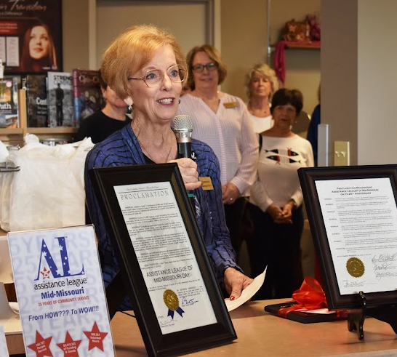
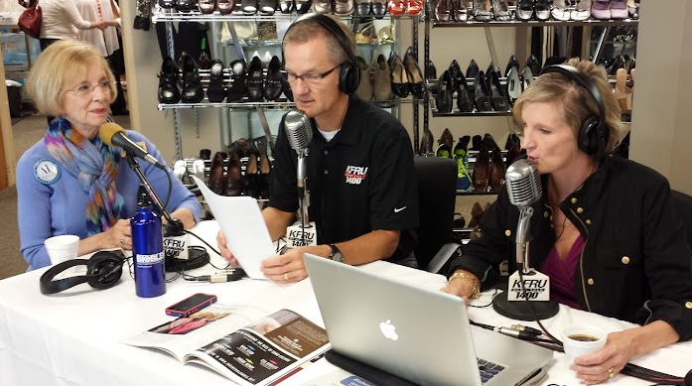
Lynnanne loves to talk about ALMM’s accomplishments . . . and she’s good at it!
Speaking at open houses, being interviewed about chapter activities, presenting to civic groups

Slide 13
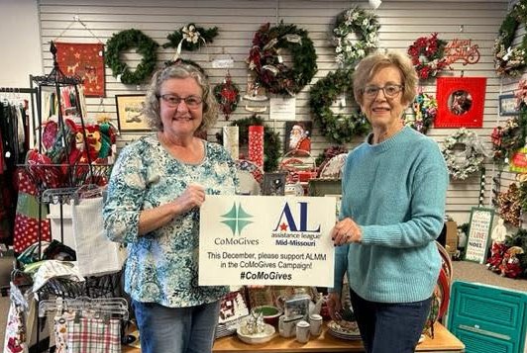
Lynnanne had the idea and wrote the “Fill Your Heart” Donor Letter in 2000 to help replace funds lost by discontinuing calendar sales.
After 22 years, the letter was replaced by CoMoGives in 2022.

Slide 14
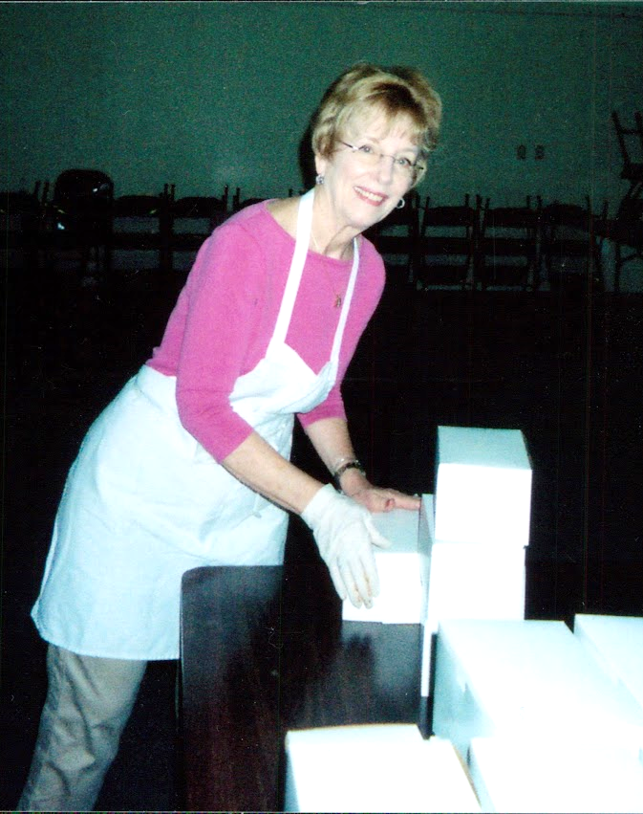
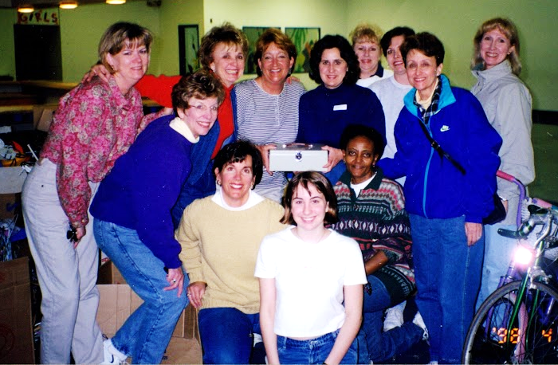
She never shies away from work––baking cookies, working garage sales, helping with ACTION! Week, condensing collection tubs in housewares.
Lynnanne is willing to do the big jobs and the little ones.

Slide 15
Many of Lynnanne’s volunteer hours have been spent organizing and managing the housewares department of Upscale Resale.
One of her team members says, “She’s a genius at organizing us and keeping the merchandise flowing from donor to customer.”

Slide 16
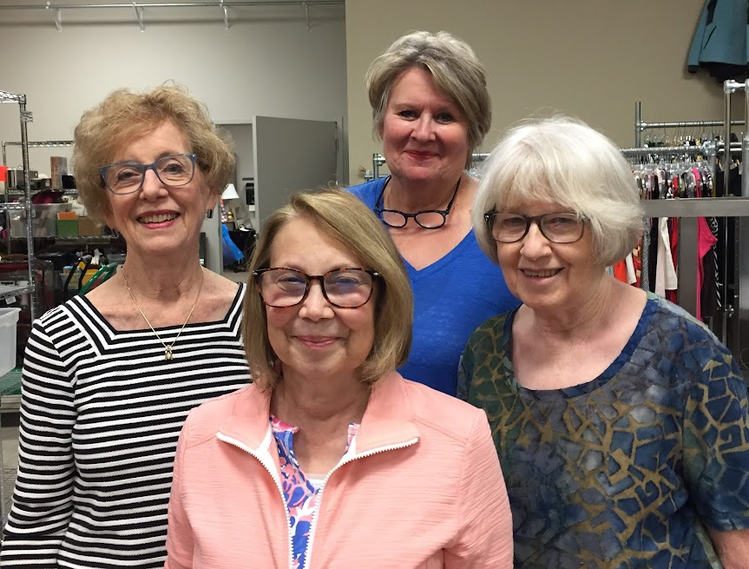
Lynnanne had four faithful helpers during the COVID closure to accept and organize donations.
They all worked many, many hours.
Kathy Corcoran, Karen Rogers,
Mary Hazelrigg (and Mary Humlicek)

Slide 17
After Upscale Resale was closed in March 2020, Lynnanne established the donation process to sort goods more efficiently.
When Upscale Resale reopened four months later, the shop was well stocked in beautiful displays.
Lynnanne is constantly improving our donation processes, storage, and displays.

Slide 18
Monday mornings, weekends, weekdays after the shop has closed—
Lynnanne might be working, putting just the right touch on our floor displays to increase sales.

Slide 19
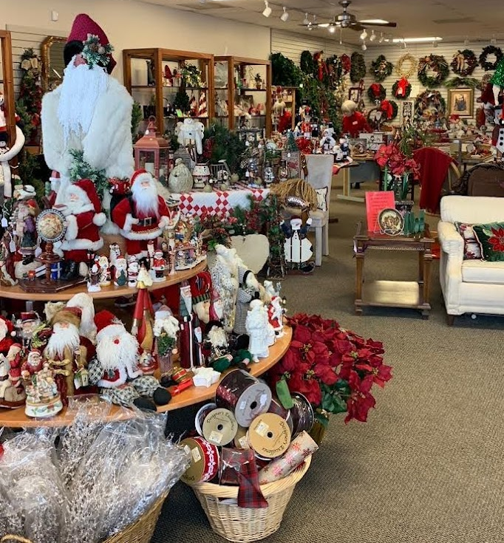
Lynnanne had the idea for the Holiday Gala evening shopping event in 2020 and continues to organize the annual event for the chapter.

Slide 20
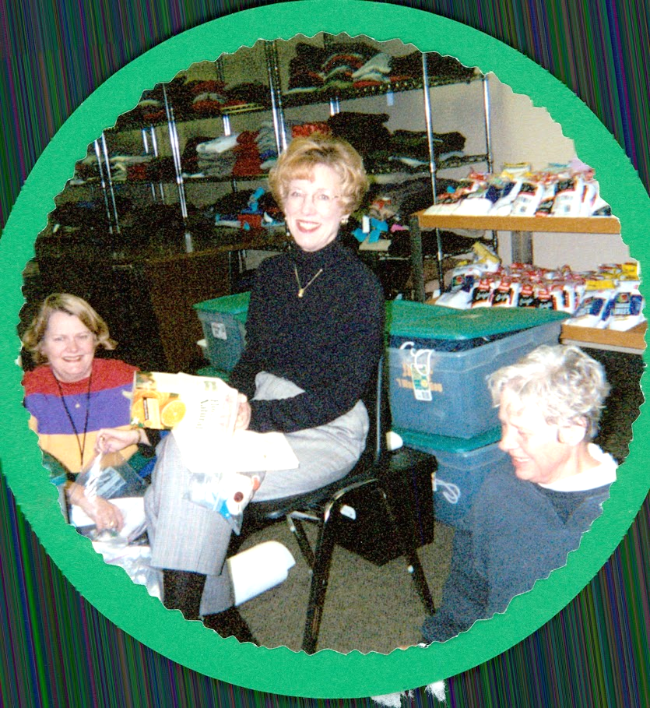
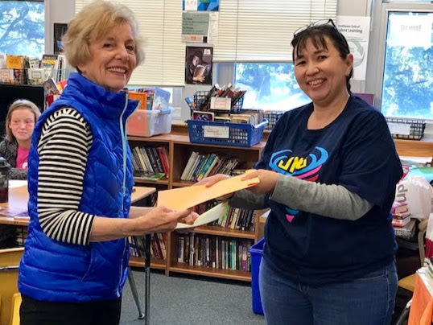
Her philanthropic contributions have included development of I Wonder Bags and evaluation and presentation of Links to Learning award for many years.

Slide 21
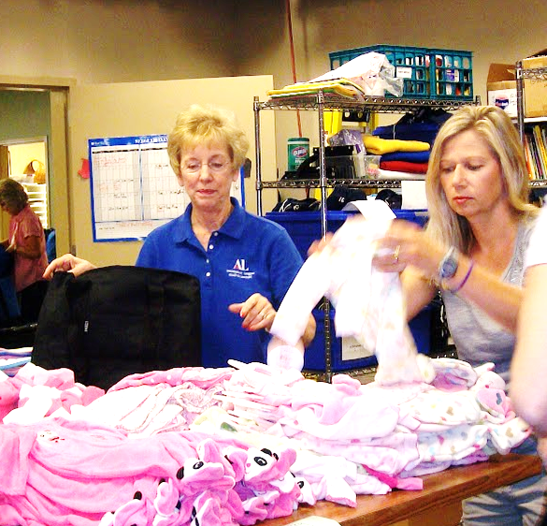
Chairing Bundles for Babies, working Operation School Bell, and serving on Scholarships—
Lynnanne’s done almost every job in the chapter.

Slide 22
Lynnanne had the idea of the Carter-MacLellan
Make-A-Difference Scholarship
in 2019.
She developed the award,
including the recognition of the two members,
Judy Carter and Becky MacLellan,
at the 20th anniversary celebration.

Slide 23
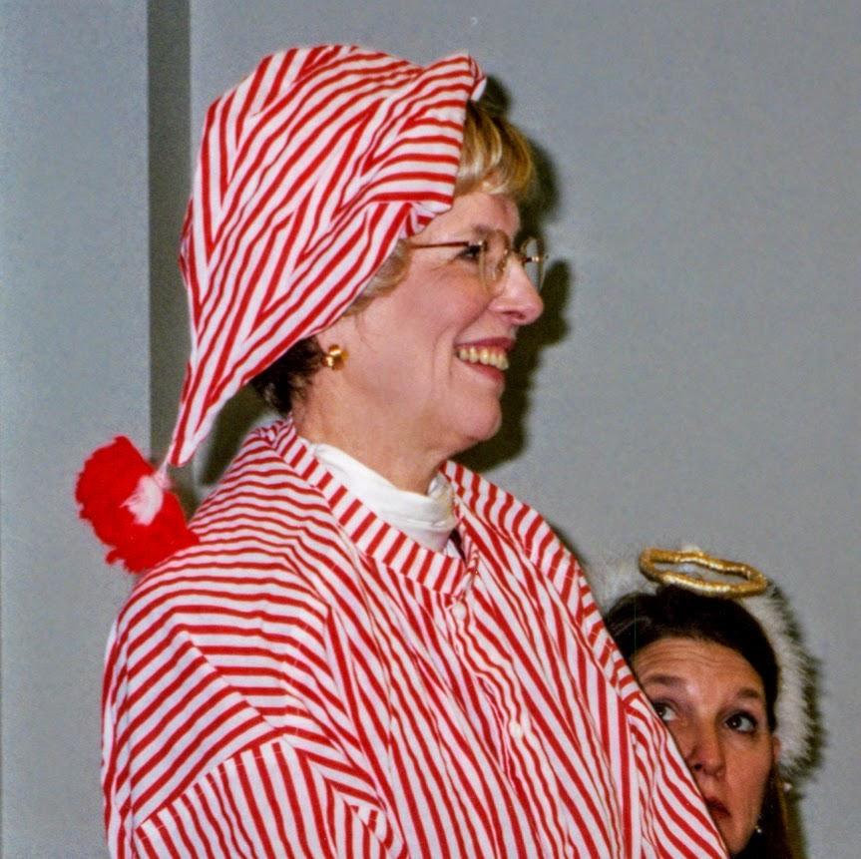
Lynnanne is a good sport, too, and enjoys chapter skits and socials, even hosting AL couples in her home for a holiday party.
Here, as outgoing president, she accepts a gift from Libby Reid, incoming president, at the May meeting.

Slide 24
Lynnanne carried the idea for the Anne Banning award
from Missouri chapter members to her national committee, who adopted the idea.
Without Lynnanne’s involvement, the award would not have been created.

Slide 25
For 30 years, Lynnanne has led chapter events:
Anniversary celebrations
Open houses for public visits
Relocating and organizing the chapter office
Relocating and expanding Upscale Resale
Organizing charter member recognition events
Organizing chapter and shop publicity
Organizing the housewares department

Slide 26
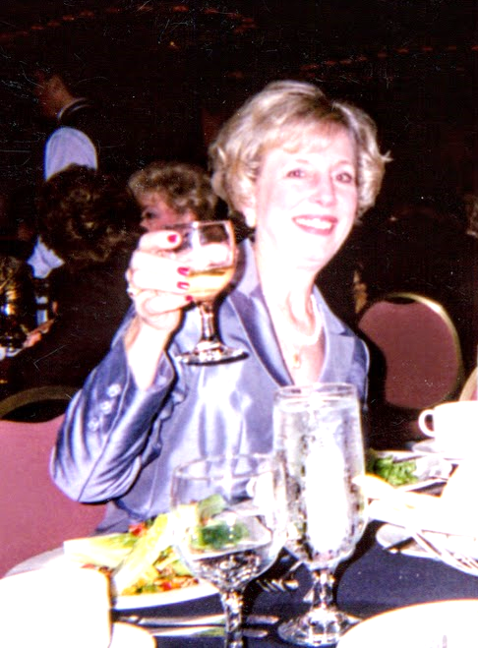
Lynnanne, no words can describe the time, effort, creativity, and love you have given to this chapter.
Thank you for setting the bar high and helping the rest of us over it.

